Slide 1

LMIs in control theory
Факультет систем управления и робототехники
Zimenko Konstantin

Slide 2


Sign-determined matrix

Slide 3
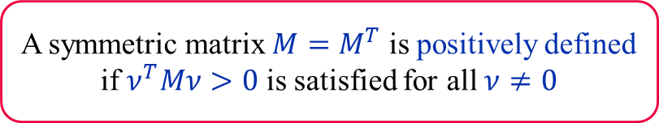
Sign-determined matrix
Positive definite matrix
A symmetric matrix $M=M^{T}$ is positively defined if $ν^{T}Mν>0$ is satisfied for all $ν≠0$

Slide 4
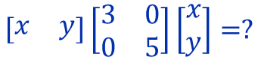
Sign-determined matrix
Positive definite matrix
A symmetric matrix $M=M^{T}$ is positively defined if $ν^{T}Mν>0$ is satisfied for all $ν≠0$
Example
$$\left[\begin{matrix}x & y\end{matrix}\right]\left[\begin{matrix}3 & 0 \\ 0 & 5\end{matrix}\right]\left[\begin{aligned}x \\ y\end{aligned}\right]=?$$

Slide 5
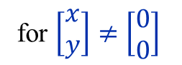
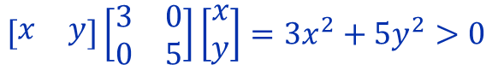
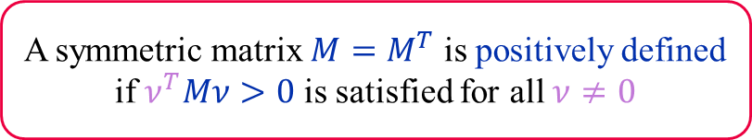
Sign-determined matrix
Positive definite matrix
A symmetric matrix $M=M^{T}$ is positively defined if $ν^{T}Mν>0$ is satisfied for all $ν≠0$
Example
$$\left[\begin{matrix}x & y\end{matrix}\right]\left[\begin{matrix}3 & 0 \\ 0 & 5\end{matrix}\right]\left[\begin{aligned}x \\ y\end{aligned}\right]=3x^{2}+5y^{2}>0$$
for $\left[\begin{aligned}x \\ y\end{aligned}\right]≠\left[\begin{aligned}0 \\ 0\end{aligned}\right]$

Slide 6
Sign-determined matrix
Positive definite matrix
A symmetric matrix $M=M^{T}$ is positively defined if $ν^{T}Mν>0$ is satisfied for all $ν≠0$
Example
$$\left[\begin{matrix}x & y\end{matrix}\right]\left[\begin{matrix}3 & 0 \\ 0 & 5\end{matrix}\right]\left[\begin{aligned}x \\ y\end{aligned}\right]=3x^{2}+5y^{2}>0$$
for $\left[\begin{aligned}x \\ y\end{aligned}\right]≠\left[\begin{aligned}0 \\ 0\end{aligned}\right]$
is positively defined

Slide 7
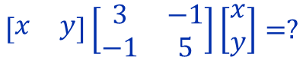
Sign-determined matrix
Positive definite matrix
A symmetric matrix $M=M^{T}$ is positively defined if $ν^{T}Mν>0$ is satisfied for all $ν≠0$
Example
$$\left[\begin{matrix}x & y\end{matrix}\right]\left[\begin{matrix}3 & −1 \\ −1 & 5\end{matrix}\right]\left[\begin{aligned}x \\ y\end{aligned}\right]=?$$

Slide 8
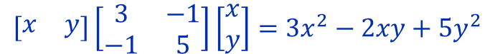
Sign-determined matrix
Positive definite matrix
A symmetric matrix $M=M^{T}$ is positively defined if $ν^{T}Mν>0$ is satisfied for all $ν≠0$
Example
$$\left[\begin{matrix}x & y\end{matrix}\right]\left[\begin{matrix}3 & −1 \\ −1 & 5\end{matrix}\right]\left[\begin{aligned}x \\ y\end{aligned}\right]=3x^{2}−2xy+5y^{2}$$

Slide 9
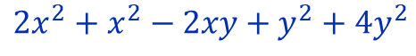
Sign-determined matrix
Positive definite matrix
A symmetric matrix $M=M^{T}$ is positively defined if $ν^{T}Mν>0$ is satisfied for all $ν≠0$
Example
$$\left[\begin{matrix}x & y\end{matrix}\right]\left[\begin{matrix}3 & −1 \\ −1 & 5\end{matrix}\right]\left[\begin{aligned}x \\ y\end{aligned}\right]=3x^{2}−2xy+5y^{2}$$
$$2x^{2}+x^{2}−2xy+y^{2}+4y^{2}$$

Slide 10
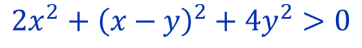
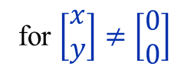
Sign-determined matrix
Positive definite matrix
A symmetric matrix $M=M^{T}$ is positively defined if $ν^{T}Mν>0$ is satisfied for all $ν≠0$
Example
$$\left[\begin{matrix}x & y\end{matrix}\right]\left[\begin{matrix}3 & −1 \\ −1 & 5\end{matrix}\right]\left[\begin{aligned}x \\ y\end{aligned}\right]=3x^{2}−2xy+5y^{2}$$
$$2x^{2}+x^{2}−2xy+y^{2}+4y^{2}$$
for $\left[\begin{aligned}x \\ y\end{aligned}\right]≠\left[\begin{aligned}0 \\ 0\end{aligned}\right]$
$$2x^{2}+{\left(x−y\right)}^{2}+4y^{2}>0$$

Slide 11
Sign-determined matrix
Positive definite matrix
A symmetric matrix $M=M^{T}$ is positively defined if $ν^{T}Mν>0$ is satisfied for all $ν≠0$
Example
$$\left[\begin{matrix}x & y\end{matrix}\right]\left[\begin{matrix}3 & −1 \\ −1 & 5\end{matrix}\right]\left[\begin{aligned}x \\ y\end{aligned}\right]=3x^{2}−2xy+5y^{2}$$
$$2x^{2}+x^{2}−2xy+y^{2}+4y^{2}$$
is positively defined
for $\left[\begin{aligned}x \\ y\end{aligned}\right]≠\left[\begin{aligned}0 \\ 0\end{aligned}\right]$
$$2x^{2}+{\left(x−y\right)}^{2}+4y^{2}>0$$

Slide 12
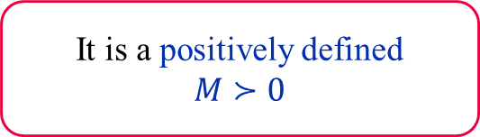
Sign-determined matrix
About the symmetric matrix $M=M^{T}$
It is a positively defined
$M≻0$

Slide 13
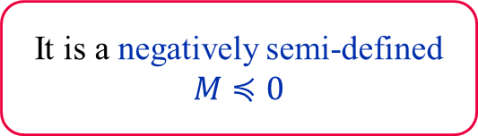
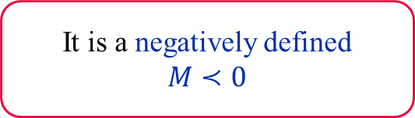
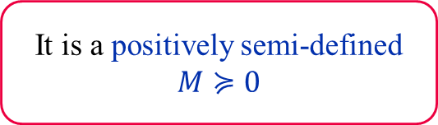
Sign-determined matrix
About the symmetric matrix $M=M^{T}$
It is a positively defined
$M≻0$
It is a positively semi-defined
$M≽0$
It is a negatively defined
$M≺0$
It is a negatively semi-defined
$M≼0$

Slide 14

Sign-determined matrix
About the symmetric matrix $M=M^{T}$
It is a positively defined
$M≻0$
It is a positively semi-defined
$M≽0$
$ν^{T}Mν>0$
It is a negatively defined
$M≺0$
It is a negatively semi-defined
$M≼0$

Slide 15



Sign-determined matrix
About the symmetric matrix $M=M^{T}$
It is a positively defined
$M≻0$
It is a positively semi-defined
$M≽0$
$ν^{T}Mν>0$
$ν^{T}Mν≥0$
It is a negatively defined
$M≺0$
It is a negatively semi-defined
$M≼0$
$$ν^{T}Mν<0$$
$$ν^{T}Mν≤0$$

Slide 16
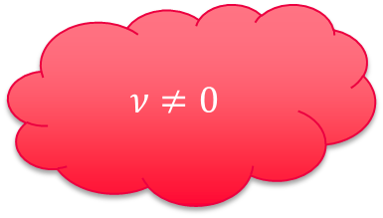
Sign-determined matrix
$$ν≠0$$
About the symmetric matrix $M=M^{T}$
It is a positively defined
$M≻0$
It is a positively semi-defined
$M≽0$
$ν^{T}Mν>0$
$ν^{T}Mν≥0$
It is a negatively defined
$M≺0$
It is a negatively semi-defined
$M≼0$
$$ν^{T}Mν<0$$
$$ν^{T}Mν≤0$$

Slide 17




Sign-determined matrix
About the symmetric matrix $M=M^{T}$
It is a positively defined
$M≻0$
It is a positively semi-defined
$M≽0$
$ν^{T}Mν>0$
$ν^{T}Mν≥0$
All $λ>0$
All $λ≥0$
It is a negatively defined
$M≺0$
It is a negatively semi-defined
$M≼0$
$$ν^{T}Mν<0$$
$$ν^{T}Mν≤0$$
$$\text{All} λ<0$$
$\text{All} λ$ $≤0$

Slide 18
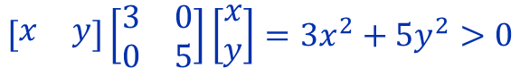

Sign-determined matrix
Example
I
$$\left[\begin{matrix}x & y\end{matrix}\right]\left[\begin{matrix}3 & 0 \\ 0 & 5\end{matrix}\right]\left[\begin{aligned}x \\ y\end{aligned}\right]=3x^{2}+5y^{2}>0$$
$$λ\left(\left[\begin{matrix}3 & 0 \\ 0 & 5\end{matrix}\right]\right)=?$$

Slide 19
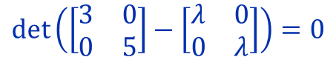
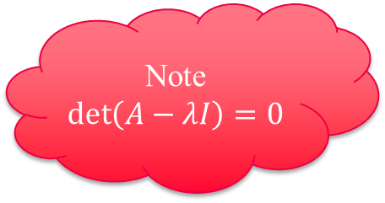
Sign-determined matrix
Note
$$\det\left(A−λI\right)=0$$
Example
I
$$\left[\begin{matrix}x & y\end{matrix}\right]\left[\begin{matrix}3 & 0 \\ 0 & 5\end{matrix}\right]\left[\begin{aligned}x \\ y\end{aligned}\right]=3x^{2}+5y^{2}>0$$
$$\det\left(\left[\begin{matrix}3 & 0 \\ 0 & 5\end{matrix}\right]−\left[\begin{matrix}λ & 0 \\ 0 & λ\end{matrix}\right]\right)=0$$
$$λ\left(\left[\begin{matrix}3 & 0 \\ 0 & 5\end{matrix}\right]\right)=?$$

Slide 20
Sign-determined matrix
Note
$$\det\left(A−λI\right)=0$$
Example
I
$$\left[\begin{matrix}x & y\end{matrix}\right]\left[\begin{matrix}3 & 0 \\ 0 & 5\end{matrix}\right]\left[\begin{aligned}x \\ y\end{aligned}\right]=3x^{2}+5y^{2}>0$$
$$\det\left(\left[\begin{matrix}3 & 0 \\ 0 & 5\end{matrix}\right]−\left[\begin{matrix}λ & 0 \\ 0 & λ\end{matrix}\right]\right)=0$$
$$λ\left(\left[\begin{matrix}3 & 0 \\ 0 & 5\end{matrix}\right]\right)=?$$

Slide 21
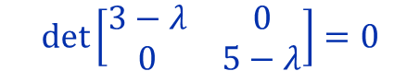
Sign-determined matrix
Note
$$\det\left(A−λI\right)=0$$
Example
I
$$\left[\begin{matrix}x & y\end{matrix}\right]\left[\begin{matrix}3 & 0 \\ 0 & 5\end{matrix}\right]\left[\begin{aligned}x \\ y\end{aligned}\right]=3x^{2}+5y^{2}>0$$
$$\det\left(\left[\begin{matrix}3 & 0 \\ 0 & 5\end{matrix}\right]−\left[\begin{matrix}λ & 0 \\ 0 & λ\end{matrix}\right]\right)=0$$
$$λ\left(\left[\begin{matrix}3 & 0 \\ 0 & 5\end{matrix}\right]\right)=?$$
$$\det\left[\begin{matrix}3−λ & 0 \\ 0 & 5−λ\end{matrix}\right]=0$$

Slide 22

Sign-determined matrix
Note
$$\det\left(A−λI\right)=0$$
Example
I
$$\left[\begin{matrix}x & y\end{matrix}\right]\left[\begin{matrix}3 & 0 \\ 0 & 5\end{matrix}\right]\left[\begin{aligned}x \\ y\end{aligned}\right]=3x^{2}+5y^{2}>0$$
$$\det\left(\left[\begin{matrix}3 & 0 \\ 0 & 5\end{matrix}\right]−\left[\begin{matrix}λ & 0 \\ 0 & λ\end{matrix}\right]\right)=0$$
$$λ\left(\left[\begin{matrix}3 & 0 \\ 0 & 5\end{matrix}\right]\right)=?$$
$$\det\left[\begin{matrix}3−λ & 0 \\ 0 & 5−λ\end{matrix}\right]=0$$
$$\left(3−λ\right)\left(5−λ\right)=0$$

Slide 23

Sign-determined matrix
Note
$$\det\left(A−λI\right)=0$$
Example
I
$$\left[\begin{matrix}x & y\end{matrix}\right]\left[\begin{matrix}3 & 0 \\ 0 & 5\end{matrix}\right]\left[\begin{aligned}x \\ y\end{aligned}\right]=3x^{2}+5y^{2}>0$$
$$\det\left(\left[\begin{matrix}3 & 0 \\ 0 & 5\end{matrix}\right]−\left[\begin{matrix}λ & 0 \\ 0 & λ\end{matrix}\right]\right)=0$$
$$λ\left(\left[\begin{matrix}3 & 0 \\ 0 & 5\end{matrix}\right]\right)=\left\{3, 5\right\}$$
$$\det\left[\begin{matrix}3−λ & 0 \\ 0 & 5−λ\end{matrix}\right]=0$$
$$\left(3−λ\right)\left(5−λ\right)=0$$

Slide 24
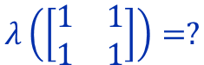
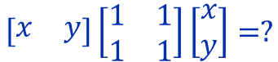
Sign-determined matrix
Note
$$\det\left(A−λI\right)=0$$
Example
I
$$\left[\begin{matrix}x & y\end{matrix}\right]\left[\begin{matrix}3 & 0 \\ 0 & 5\end{matrix}\right]\left[\begin{aligned}x \\ y\end{aligned}\right]=3x^{2}+5y^{2}>0$$
$$λ\left(\left[\begin{matrix}3 & 0 \\ 0 & 5\end{matrix}\right]\right)=\left\{3, 5\right\}$$
II
$$\left[\begin{matrix}x & y\end{matrix}\right]\left[\begin{matrix}1 & 1 \\ 1 & 1\end{matrix}\right]\left[\begin{aligned}x \\ y\end{aligned}\right]=?$$
$$λ\left(\left[\begin{matrix}1 & 1 \\ 1 & 1\end{matrix}\right]\right)=?$$

Slide 25
Sign-determined matrix
Note
$$\det\left(A−λI\right)=0$$
Example
I
$$\left[\begin{matrix}x & y\end{matrix}\right]\left[\begin{matrix}3 & 0 \\ 0 & 5\end{matrix}\right]\left[\begin{aligned}x \\ y\end{aligned}\right]=3x^{2}+5y^{2}>0$$
$$λ\left(\left[\begin{matrix}3 & 0 \\ 0 & 5\end{matrix}\right]\right)=\left\{3, 5\right\}$$
$$\left[\begin{matrix}x & y\end{matrix}\right]\left[\begin{matrix}1 & 1 \\ 1 & 1\end{matrix}\right]\left[\begin{aligned}x \\ y\end{aligned}\right]=x^{2}+2xy+y^{2}={\left(x+y\right)}^{2}$$
II
$$λ\left(\left[\begin{matrix}1 & 1 \\ 1 & 1\end{matrix}\right]\right)=?$$

Slide 26
Sign-determined matrix
Note
$$\det\left(A−λI\right)=0$$
Example
I
$$\left[\begin{matrix}x & y\end{matrix}\right]\left[\begin{matrix}3 & 0 \\ 0 & 5\end{matrix}\right]\left[\begin{aligned}x \\ y\end{aligned}\right]=3x^{2}+5y^{2}>0$$
$$λ\left(\left[\begin{matrix}3 & 0 \\ 0 & 5\end{matrix}\right]\right)=\left\{3, 5\right\}$$
$$\left[\begin{matrix}x & y\end{matrix}\right]\left[\begin{matrix}1 & 1 \\ 1 & 1\end{matrix}\right]\left[\begin{aligned}x \\ y\end{aligned}\right]=x^{2}+2xy+y^{2}={\left(x+y\right)}^{2}≥0$$
II
$$λ\left(\left[\begin{matrix}1 & 1 \\ 1 & 1\end{matrix}\right]\right)=?$$

Slide 27
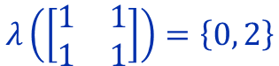
Sign-determined matrix
Note
$$\det\left(A−λI\right)=0$$
Example
I
$$\left[\begin{matrix}x & y\end{matrix}\right]\left[\begin{matrix}3 & 0 \\ 0 & 5\end{matrix}\right]\left[\begin{aligned}x \\ y\end{aligned}\right]=3x^{2}+5y^{2}>0$$
$$λ\left(\left[\begin{matrix}3 & 0 \\ 0 & 5\end{matrix}\right]\right)=\left\{3, 5\right\}$$
$$\left[\begin{matrix}x & y\end{matrix}\right]\left[\begin{matrix}1 & 1 \\ 1 & 1\end{matrix}\right]\left[\begin{aligned}x \\ y\end{aligned}\right]=x^{2}+2xy+y^{2}={\left(x+y\right)}^{2}≥0$$
II
$$λ\left(\left[\begin{matrix}1 & 1 \\ 1 & 1\end{matrix}\right]\right)=\left\{0, 2\right\}$$

Slide 28
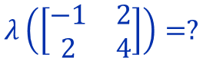

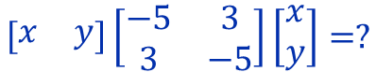
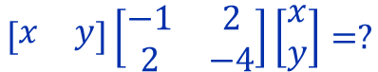
Sign-determined matrix
Example
III
IV
$$\left[\begin{matrix}x & y\end{matrix}\right]\left[\begin{matrix}−5 & 3 \\ 3 & −5\end{matrix}\right]\left[\begin{aligned}x \\ y\end{aligned}\right]=?$$
$$\left[\begin{matrix}x & y\end{matrix}\right]\left[\begin{matrix}−1 & 2 \\ 2 & −4\end{matrix}\right]\left[\begin{aligned}x \\ y\end{aligned}\right]=?$$
$$λ\left(\left[\begin{matrix}−1 & 2 \\ 2 & 4\end{matrix}\right]\right)=?$$
$$λ\left(\left[\begin{matrix}−1 & 2 \\ 2 & 4\end{matrix}\right]\right)=?$$

Slide 29
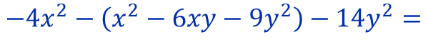
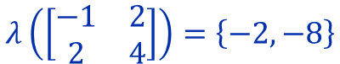
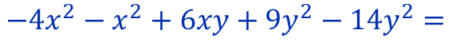
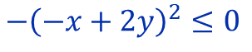
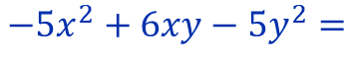
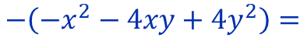
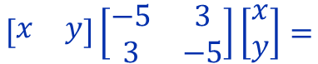
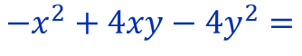
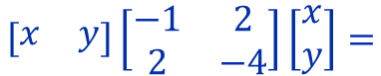
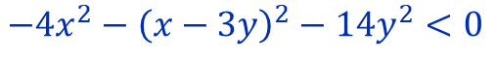
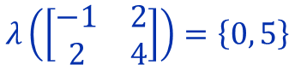
Sign-determined matrix
Example
III
IV
$$\left[\begin{matrix}x & y\end{matrix}\right]\left[\begin{matrix}−5 & 3 \\ 3 & −5\end{matrix}\right]\left[\begin{aligned}x \\ y\end{aligned}\right]=$$
$$\left[\begin{matrix}x & y\end{matrix}\right]\left[\begin{matrix}−1 & 2 \\ 2 & −4\end{matrix}\right]\left[\begin{aligned}x \\ y\end{aligned}\right]=$$
$$−5x^{2}+6xy−5y^{2}=$$
$$−x^{2}+4xy−4y^{2}=$$
$$−4x^{2}−x^{2}+6xy+9y^{2}−14y^{2}=$$
$$−\left(−x^{2}−4xy+4y^{2}\right)=$$
$$−4x^{2}−\left(x^{2}−6xy−9y^{2}\right)−14y^{2}=$$
$$−{\left(−x+2y\right)}^{2}≤0$$
$$−4x^{2}−{\left(x−3y\right)}^{2}−14y^{2}<0$$
$$λ\left(\left[\begin{matrix}−1 & 2 \\ 2 & 4\end{matrix}\right]\right)=\left\{−2, −8\right\}$$
$$λ\left(\left[\begin{matrix}−1 & 2 \\ 2 & 4\end{matrix}\right]\right)=\left\{0, 5\right\}$$

Slide 30
Matrix inequalities

Slide 31
Matrix inequalities
Matrix inequalities
Linear Matrix Inequalities
(LMI)
Nonlinear Matrix Inequalities

Slide 32
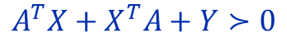
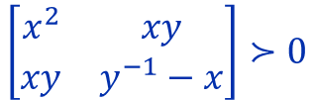
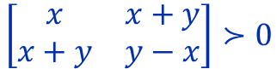
Matrix inequalities
Matrix inequalities
Linear Matrix Inequalities
(LMI)
Nonlinear Matrix Inequalities
I
$$\left[\begin{matrix}x & x+y \\ x+y & y−x\end{matrix}\right]≻0$$
$$\left[\begin{matrix}x^{2} & xy \\ xy & y^{−1}−x\end{matrix}\right]≻0$$
II
$$A^{T}X+X^{T}A+Y≻0$$
$$Y^{T}A^{T}X+X^{T}B+{B^{T}\left(XY\right)}^{−1}B≻0$$

Slide 33
Matrix inequalities
let's remember

Slide 34
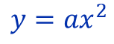
Matrix inequalities
What is it?
let's remember
$$y=ax^{2}$$

Slide 35
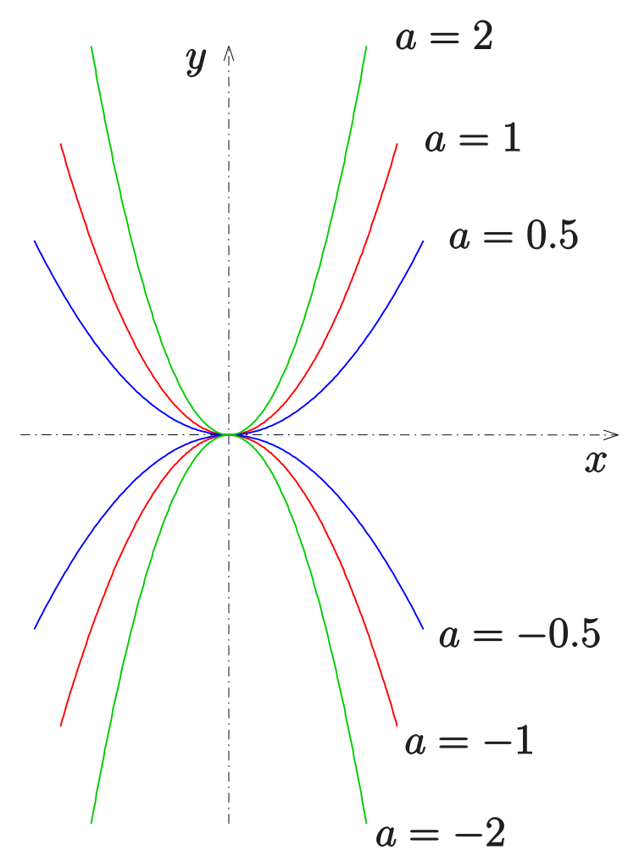
Matrix inequalities
What is it?
let's remember
$$y=ax^{2}$$

Slide 36
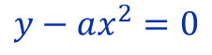
Matrix inequalities
let's remember
$$y=ax^{2}$$
$$y−ax^{2}=0$$
In the LMI case
We can also define lines and areas

Slide 37
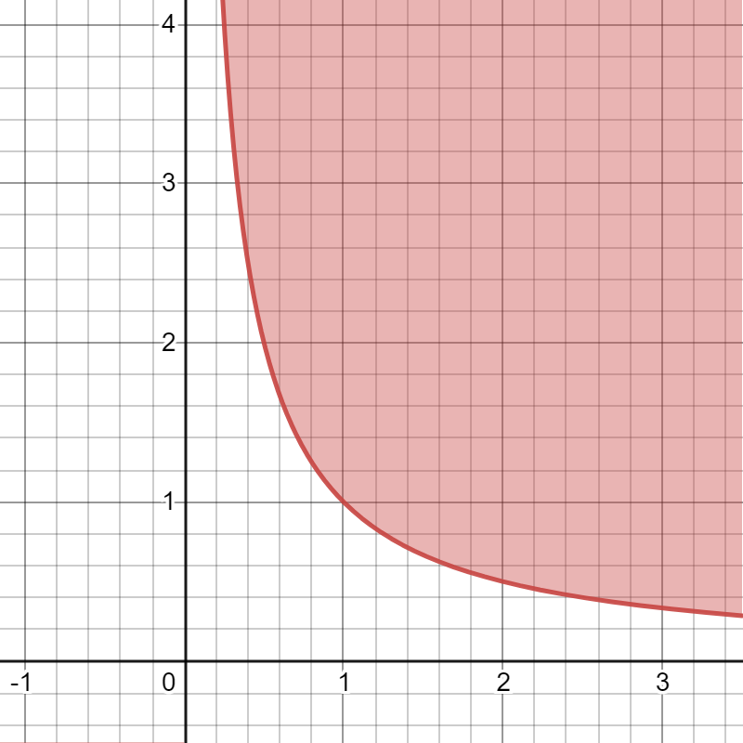
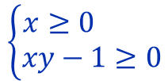
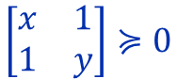
Matrix inequalities
Example
I
$$\left[\begin{matrix}x & 1 \\ 1 & y\end{matrix}\right]≽0$$
$$\left\{\begin{aligned}x≥0 \\ xy−1≥0\end{aligned}\right.$$

Slide 38
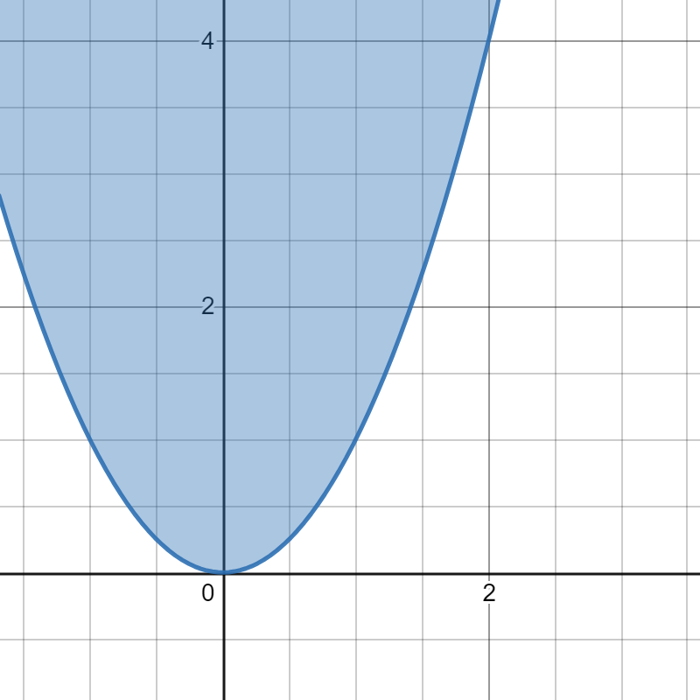
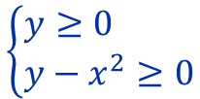
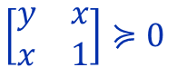
Matrix inequalities
Example
I
$$\left[\begin{matrix}x & 1 \\ 1 & y\end{matrix}\right]≽0$$
$$\left\{\begin{aligned}x≥0 \\ xy−1≥0\end{aligned}\right.$$
II
$$\left[\begin{matrix}y & x \\ x & 1\end{matrix}\right]≽0$$
$$\left\{\begin{aligned}y≥0 \\ y−x^{2}≥0\end{aligned}\right.$$

Slide 39
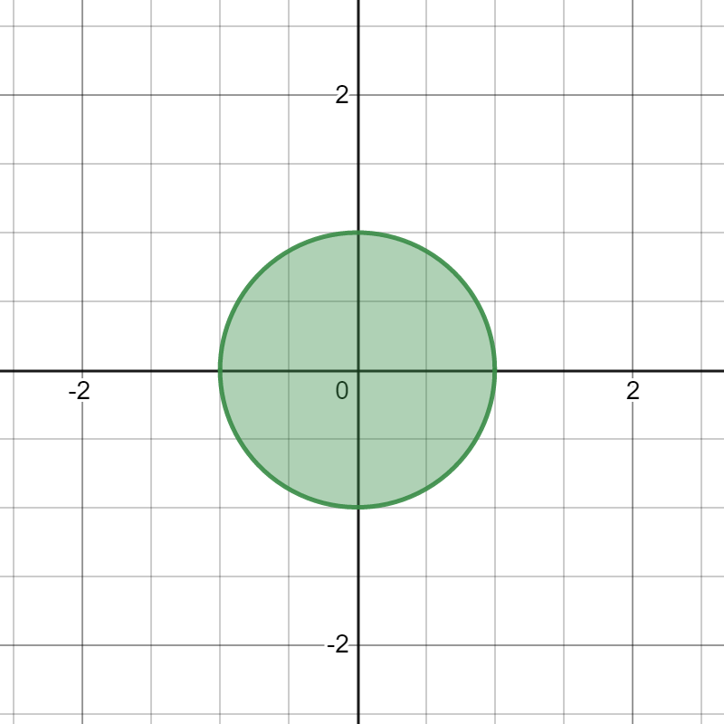
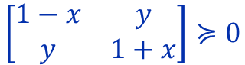

Matrix inequalities
Example
I
$$\left[\begin{matrix}x & 1 \\ 1 & y\end{matrix}\right]≽0$$
$$\left\{\begin{aligned}x≥0 \\ xy−1≥0\end{aligned}\right.$$
II
$$\left[\begin{matrix}y & x \\ x & 1\end{matrix}\right]≽0$$
$$\left\{\begin{aligned}y≥0 \\ y−x^{2}≥0\end{aligned}\right.$$
III
$$\left[\begin{matrix}1−x & y \\ y & 1+x\end{matrix}\right]≽0$$
$$\left\{\begin{aligned}1−x≥0 \\ \left(1−x\right)\left(1+x\right)−y^{2}≥0\end{aligned}\right.$$

Slide 40

Method Lyapunov Function

Slide 41


Method Lyapunov Function
let's remember
System
$$\dot{x}=f\left(x\right)$$
$$f:ℝ^{n}→ℝ^{n}$$

Slide 42




Method Lyapunov Function
let's remember
System
$$\dot{x}=f\left(x\right)$$
$$f:ℝ^{n}→ℝ^{n}$$
is stable if there exists such a $V:ℝ^{n}→ℝ^{n}$ that
$$\left\{\begin{aligned}V\left(0\right)=0 \\ V\left(x\right)>0\end{aligned}\right.$$
$$\left\{\begin{aligned}\dot{V}\left(0\right)=0 \\ \dot{V}\left(x\right)<0\end{aligned}\right.$$
for $x≠0$
for $x≠0$

Slide 43
Method Lyapunov Function
let's remember
System
$$\dot{x}=f\left(x\right)$$
$$f:ℝ^{n}→ℝ^{n}$$
is stable if there exists such a $V:ℝ^{n}→ℝ^{n}$ that
$$\left\{\begin{aligned}V\left(0\right)=0 \\ V\left(x\right)>0\end{aligned}\right.$$
$$\left\{\begin{aligned}\dot{V}\left(0\right)=0 \\ \dot{V}\left(x\right)<0\end{aligned}\right.$$
for $x≠0$
for $x≠0$
than $x=0$ is an asymptotically stable point.

Slide 44


Method Lyapunov Function
Lyapunov Function
Linear case
$$\dot{x}=Ax,$$
$$A∈ℝ^{n×n}.$$

Slide 45

Method Lyapunov Function
Lyapunov Function
Linear case
$$\dot{x}=Ax,$$
$$A∈ℝ^{n×n}.$$
Let 's choose the following as the Lyapunov function
$$V\left(x\right)=x^{T}Qx$$

Slide 46

Method Lyapunov Function
Lyapunov Function
Linear case
$$\dot{x}=Ax,$$
$$A∈ℝ^{n×n}.$$
Let 's choose the following as the Lyapunov function
$$V\left(x\right)=x^{T}Qx$$
Consider its derivative
$$\dot{V}\left(x\right)={\dot{x}}^{T}Qx+x^{T}Q\dot{x}$$

Slide 47



Method Lyapunov Function
Lyapunov Function
Linear case
$$\dot{x}=Ax,$$
$$A∈ℝ^{n×n}.$$
Let 's choose the following as the Lyapunov function
$$V\left(x\right)=x^{T}Qx$$
Consider its derivative
$$\dot{V}\left(x\right)={\dot{x}}^{T}Qx+x^{T}Q\dot{x}$$
$$={\left(Ax\right)}^{T}Qx+x^{T}Q\left(Ax\right)$$
$$=x^{T}A^{T}Qx+x^{T}QAx$$
$$=x^{T}\left(A^{T}Q+QA\right)x$$

Slide 48

Method Lyapunov Function
Lyapunov Function
Linear case
$$\dot{x}=Ax,$$
$$A∈ℝ^{n×n}.$$
Let 's choose the following as the Lyapunov function
$$V\left(x\right)=x^{T}Qx$$
Consider its derivative
$$\dot{V}\left(x\right)={\dot{x}}^{T}Qx+x^{T}Q\dot{x}$$
$$={\left(Ax\right)}^{T}Qx+x^{T}Q\left(Ax\right)$$
$$=x^{T}A^{T}Qx+x^{T}QAx$$
$$=x^{T}\left(A^{T}Q+QA\right)x$$
What is $Q$ ?

Slide 49

Method Lyapunov Function
Lyapunov Function
Linear case
$$\dot{x}=Ax,$$
$$A∈ℝ^{n×n}.$$
Let 's choose the following as the Lyapunov function
$$V\left(x\right)=x^{T}Qx$$
Consider its derivative
$$\dot{V}\left(x\right)=x^{T}\left(A^{T}Q+QA\right)x$$

Slide 50

Method Lyapunov Function
Lyapunov Function
Linear case
$$\dot{x}=Ax,$$
$$A∈ℝ^{n×n}.$$
Let 's choose the following as the Lyapunov function
$$V\left(x\right)=x^{T}Qx$$
Asymptotic stability
$$\dot{V}\left(x\right)<0$$
Consider its derivative
$$\dot{V}\left(x\right)=x^{T}\left(A^{T}Q+QA\right)x$$

Slide 51


Method Lyapunov Function
Lyapunov Function
Linear case
$$\dot{x}=Ax,$$
$$A∈ℝ^{n×n}.$$
Let 's choose the following as the Lyapunov function
$$V\left(x\right)=x^{T}Qx$$
Asymptotic stability
$$\dot{V}\left(x\right)<0$$
Consider its derivative
$$\dot{V}\left(x\right)=x^{T}\left(A^{T}Q+QA\right)x$$
$$\left\{\begin{aligned}Q≻0 \\ A^{T}Q+QA≺0\end{aligned}\right.$$

Slide 52

Method Lyapunov Function
Lyapunov Function
Linear case
$$\dot{x}=Ax,$$
$$A∈ℝ^{n×n}.$$
Lyapunov’s inequality
$$\left\{\begin{aligned}Q≻0 \\ A^{T}Q+QA≺0\end{aligned}\right.$$

Slide 53

Method Lyapunov Function
Lyapunov Function
Linear case
$$\dot{x}=Ax,$$
$$A∈ℝ^{n×n}.$$
Lyapunov’s inequality
$$\left\{\begin{aligned}Q≻0 \\ A^{T}Q+QA≺0\end{aligned}\right.$$
Lyapunov’s equation
$$\left\{\begin{aligned}Q≻0 \\ R≻0 \\ A^{T}Q+QA≺−R\end{aligned}\right.$$

Slide 54
Method Lyapunov Function
Lyapunov Function
Linear case
$$\dot{x}=Ax,$$
$$A∈ℝ^{n×n}.$$
Lyapunov’s inequality
$$\left\{\begin{aligned}Q≻0 \\ A^{T}Q+QA≺0\end{aligned}\right.$$
What is the difference ?
Lyapunov’s equation
$$\left\{\begin{aligned}Q≻0 \\ R≻0 \\ A^{T}Q+QA≺−R\end{aligned}\right.$$

Slide 55

Method Lyapunov Function
Example
Linear systems
$$\left[\begin{aligned}{\dot{x}}_{1} \\ {\dot{x}}_{2}\end{aligned}\right]=\left[\begin{matrix}−1 & 1 \\ 0 & −1\end{matrix}\right]\left[\begin{aligned}x_{1} \\ x_{2}\end{aligned}\right],$$

Slide 56


Method Lyapunov Function
Example
Linear systems
$$\left[\begin{aligned}{\dot{x}}_{1} \\ {\dot{x}}_{2}\end{aligned}\right]=\left[\begin{matrix}−1 & 1 \\ 0 & −1\end{matrix}\right]\left[\begin{aligned}x_{1} \\ x_{2}\end{aligned}\right],$$
Choose $R≻0$
$$R=\left[\begin{matrix}2 & 0 \\ 0 & 3\end{matrix}\right]$$

Slide 57

Method Lyapunov Function
Example
Linear systems
$$\left[\begin{aligned}{\dot{x}}_{1} \\ {\dot{x}}_{2}\end{aligned}\right]=\left[\begin{matrix}−1 & 1 \\ 0 & −1\end{matrix}\right]\left[\begin{aligned}x_{1} \\ x_{2}\end{aligned}\right],$$
Choose $R≻0$
$$R=\left[\begin{matrix}2 & 0 \\ 0 & 3\end{matrix}\right]$$
Lyapunov’s equation
$$A^{T}\left[\begin{matrix}q_{1} & q_{2} \\ q_{2} & q_{3}\end{matrix}\right]+\left[\begin{matrix}q_{1} & q_{2} \\ q_{2} & q_{3}\end{matrix}\right]A≺−R$$

Slide 58
Method Lyapunov Function
Example
Linear systems
$$\left[\begin{aligned}{\dot{x}}_{1} \\ {\dot{x}}_{2}\end{aligned}\right]=\left[\begin{matrix}−1 & 1 \\ 0 & −1\end{matrix}\right]\left[\begin{aligned}x_{1} \\ x_{2}\end{aligned}\right],$$
Choose $R≻0$
$$R=\left[\begin{matrix}2 & 0 \\ 0 & 3\end{matrix}\right]$$
Lyapunov’s equation
$$A^{T}\left[\begin{matrix}q_{1} & q_{2} \\ q_{2} & q_{3}\end{matrix}\right]+\left[\begin{matrix}q_{1} & q_{2} \\ q_{2} & q_{3}\end{matrix}\right]A≺−R$$
$$\left[\begin{matrix}−1 & 0 \\ 1 & −1\end{matrix}\right]\left[\begin{matrix}q_{1} & q_{2} \\ q_{2} & q_{3}\end{matrix}\right]+\left[\begin{matrix}q_{1} & q_{2} \\ q_{2} & q_{3}\end{matrix}\right]\left[\begin{matrix}−1 & 1 \\ 0 & −1\end{matrix}\right]≺−\left[\begin{matrix}2 & 0 \\ 0 & 3\end{matrix}\right]$$

Slide 59
Method Lyapunov Function
Example
Linear systems
$$\left[\begin{aligned}{\dot{x}}_{1} \\ {\dot{x}}_{2}\end{aligned}\right]=\left[\begin{matrix}−1 & 1 \\ 0 & −1\end{matrix}\right]\left[\begin{aligned}x_{1} \\ x_{2}\end{aligned}\right],$$
Choose $R≻0$
$$R=\left[\begin{matrix}2 & 0 \\ 0 & 3\end{matrix}\right]$$
Lyapunov’s equation
$$A^{T}\left[\begin{matrix}q_{1} & q_{2} \\ q_{2} & q_{3}\end{matrix}\right]+\left[\begin{matrix}q_{1} & q_{2} \\ q_{2} & q_{3}\end{matrix}\right]A≺−R$$
$$\left[\begin{matrix}−q_{1} & −q_{2} \\ q_{1}−q_{2} & q_{2}−q_{3}\end{matrix}\right]+\left[\begin{matrix}−q_{1} & q_{1}−q_{2} \\ −q_{2} & q_{2}−q_{3}\end{matrix}\right]≺−\left[\begin{matrix}2 & 0 \\ 0 & 3\end{matrix}\right]$$

Slide 60

Method Lyapunov Function
Example
Linear systems
$$\left[\begin{aligned}{\dot{x}}_{1} \\ {\dot{x}}_{2}\end{aligned}\right]=\left[\begin{matrix}−1 & 1 \\ 0 & −1\end{matrix}\right]\left[\begin{aligned}x_{1} \\ x_{2}\end{aligned}\right],$$
Choose $R≻0$
$$R=\left[\begin{matrix}2 & 0 \\ 0 & 3\end{matrix}\right]$$
Lyapunov’s equation
$$A^{T}\left[\begin{matrix}q_{1} & q_{2} \\ q_{2} & q_{3}\end{matrix}\right]+\left[\begin{matrix}q_{1} & q_{2} \\ q_{2} & q_{3}\end{matrix}\right]A≺−R$$
$$\left[\begin{matrix}−2q_{1} & q_{1}−2q_{2} \\ q_{1}−2q_{2} & 2q_{2}−2q_{3}\end{matrix}\right]=−\left[\begin{matrix}2 & 0 \\ 0 & 3\end{matrix}\right]$$

Slide 61

Method Lyapunov Function
Example
Linear systems
$$\left[\begin{aligned}{\dot{x}}_{1} \\ {\dot{x}}_{2}\end{aligned}\right]=\left[\begin{matrix}−1 & 1 \\ 0 & −1\end{matrix}\right]\left[\begin{aligned}x_{1} \\ x_{2}\end{aligned}\right],$$
Choose $R≻0$
$$R=\left[\begin{matrix}2 & 0 \\ 0 & 3\end{matrix}\right]$$
Lyapunov’s equation
$$A^{T}\left[\begin{matrix}q_{1} & q_{2} \\ q_{2} & q_{3}\end{matrix}\right]+\left[\begin{matrix}q_{1} & q_{2} \\ q_{2} & q_{3}\end{matrix}\right]A≺−R$$
$$\left[\begin{matrix}q_{1} & q_{2} \\ q_{2} & q_{3}\end{matrix}\right]=\left[\begin{matrix}1 & 0,5 \\ 0,5 & 2\end{matrix}\right]≻0$$

Slide 62


Method Lyapunov Function
Example
Linear systems
$$\left[\begin{aligned}{\dot{x}}_{1} \\ {\dot{x}}_{2}\end{aligned}\right]=\left[\begin{matrix}−1 & 1 \\ 0 & −1\end{matrix}\right]\left[\begin{aligned}x_{1} \\ x_{2}\end{aligned}\right],$$
Choose $R≻0$
$$R=\left[\begin{matrix}2 & 0 \\ 0 & 3\end{matrix}\right]$$
Lyapunov’s equation
$$Q=\left[\begin{matrix}1 & 0,5 \\ 0,5 & 2\end{matrix}\right]≻0$$
The system is asymptotically stable
$$A^{T}Q+QA≺−R$$

Slide 63

Method Lyapunov Function
Example
Linear systems
$$\left[\begin{aligned}{\dot{x}}_{1} \\ {\dot{x}}_{2}\end{aligned}\right]=\left[\begin{matrix}−1 & 1 \\ 0 & −1\end{matrix}\right]\left[\begin{aligned}x_{1} \\ x_{2}\end{aligned}\right],$$
Choose $R≻0$
$$R=\left[\begin{matrix}2 & 0 \\ 0 & 3\end{matrix}\right]$$
Lyapunov’s equation
$$V\left(x\right)=x^{T}Qx$$
$$Q=\left[\begin{matrix}1 & 0,5 \\ 0,5 & 2\end{matrix}\right]≻0$$
$$A^{T}Q+QA≺−R$$

Slide 64

Method Lyapunov Function
Example
Linear systems
$$\left[\begin{aligned}{\dot{x}}_{1} \\ {\dot{x}}_{2}\end{aligned}\right]=\left[\begin{matrix}−1 & 1 \\ 0 & −1\end{matrix}\right]\left[\begin{aligned}x_{1} \\ x_{2}\end{aligned}\right],$$
Choose $R≻0$
$$R=\left[\begin{matrix}2 & 0 \\ 0 & 3\end{matrix}\right]$$
Lyapunov’s equation
$$V\left(x\right)=x^{T}Qx$$
$$Q=\left[\begin{matrix}1 & 0,5 \\ 0,5 & 2\end{matrix}\right]≻0$$
$$V\left(x\right)=x^{2}+x_{1}x_{2}+2x_{2}^{2}>0$$
$$A^{T}Q+QA≺−R$$

Slide 65

Method Lyapunov Function
Example
Linear systems
$$\left[\begin{aligned}{\dot{x}}_{1} \\ {\dot{x}}_{2}\end{aligned}\right]=\left[\begin{matrix}−1 & 1 \\ 0 & −1\end{matrix}\right]\left[\begin{aligned}x_{1} \\ x_{2}\end{aligned}\right],$$
Choose $R≻0$
$$R=\left[\begin{matrix}2 & 0 \\ 0 & 3\end{matrix}\right]$$
Lyapunov’s equation
$$V\left(x\right)=x^{T}Qx$$
$$Q=\left[\begin{matrix}1 & 0,5 \\ 0,5 & 2\end{matrix}\right]≻0$$
$$V\left(x\right)=x^{2}+x_{1}x_{2}+2x_{2}^{2}>0$$
$$\dot{V}\left(x\right)=−2x_{1}^{2}−3x_{2}^{2}<0$$
$$A^{T}Q+QA≺−R$$

Slide 66
Method Lyapunov Function
Example
Linear systems
$$\left[\begin{aligned}{\dot{x}}_{1} \\ {\dot{x}}_{2}\end{aligned}\right]=\left[\begin{matrix}−1 & 1 \\ 0 & −1\end{matrix}\right]\left[\begin{aligned}x_{1} \\ x_{2}\end{aligned}\right],$$
asymptotically
stable
Choose $R≻0$
$$R=\left[\begin{matrix}2 & 0 \\ 0 & 3\end{matrix}\right]$$
Lyapunov’s equation
$$V\left(x\right)=x^{T}Qx$$
$$Q=\left[\begin{matrix}1 & 0,5 \\ 0,5 & 2\end{matrix}\right]≻0$$
$$V\left(x\right)=x^{2}+x_{1}x_{2}+2x_{2}^{2}>0$$
$$\dot{V}\left(x\right)=−2x_{1}^{2}−3x_{2}^{2}<0$$
$$A^{T}Q+QA≺−R$$

Slide 67


Method Lyapunov Function
Let’s remember - Types of stability
The system
$$x\left(t_{0}\right)=x_{0}∈ℝ^{n}$$
$$\dot{x}=f\left(x\right)$$
is said to be stable in the sense of Lyapunov with respect to the equilibrium $x^{∗}=0$, if …

Slide 68

Method Lyapunov Function
Let’s remember - Types of stability
The system
$$x\left(t_{0}\right)=x_{0}∈ℝ^{n}$$
$$\dot{x}=f\left(x\right)$$
is said to be stable in the sense of Lyapunov with respect to the equilibrium $x^{∗}=0$, if for any $ε>0$ and initial time $t_{0}≥0$, there exist a constant, $δ=δ\left(ε,t_{0}\right)>0$, such that

Slide 69





Method Lyapunov Function
Let’s remember - Types of stability
The system
$$x\left(t_{0}\right)=x_{0}∈ℝ^{n}$$
$$\dot{x}=f\left(x\right)$$
is said to be stable in the sense of Lyapunov with respect to the equilibrium $x^{∗}=0$, if for any $ε>0$ and initial time $t_{0}≥0$, there exist a constant, $δ=δ\left(ε,t_{0}\right)>0$, such that
$$\left\|x\left(t_{0}\right)\right\|<δ$$
$$⇓$$
For all $t≥t_{0}$
$$\left\|x\left(t\right)\right\|<ε$$

Slide 70




Method Lyapunov Function
Let’s remember - Types of stability
The system
$$x\left(t_{0}\right)=x_{0}∈ℝ^{n}$$
$$\dot{x}=f\left(x\right)$$
is said to be asymptotically stable about its equilibrium $x^{∗}=0$, if it stable in the sense of Lyapunov and, furthermore, there exists a constant, $δ=δ\left(ε,t_{0}\right)>0$ such that
$$\left\|x\left(t_{0}\right)\right\|<δ$$
$$⇓$$
as $t→∞$
$$\left\|x\left(t\right)\right\|→0$$

Slide 71





Method Lyapunov Function
Let’s remember - Types of stability
The asymptotic stability is said to be uniform if the existing constant $δ$ is independent of $t_{0}$ over $δ\left[0,∞\right)$, and is said to be global if the convergence, $\left\|x\right\|→0$, is independent of the initial state $x(t_{0})$ over the entire spatial domain on which the system is defined (e.g. when $δ=∞$). If furthermore
$$\left\|x\left(t_{0}\right)\right\|<δ$$
$$⇓$$
$$\left\|x\left(t\right)\right\|≤c\left\|x\left(t_{0}\right)\right\|e^{−σt}$$
for two positive constants $c$ and $σ$, then the equilibrium is said to be exponentially stable.

Slide 72
Method Lyapunov Function
Let’s remember - Types of stability
The asymptotic stability is said to be uniform if the existing constant $δ$ is independent of $t_{0}$ over $δ\left[0,∞\right)$, and is said to be global if the convergence, $\left\|x\right\|→0$, is independent of the initial state $x(t_{0})$ over the entire spatial domain on which the system is defined (e.g. when $δ=∞$). If furthermore
Converges exponentially.
$$\left\|x\left(t_{0}\right)\right\|<δ$$
$$⇓$$
$$\left\|x\left(t\right)\right\|≤c\left\|x\left(t_{0}\right)\right\|e^{−σt}$$
for two positive constants $c$ and $σ$, then the equilibrium is said to be exponentially stable.

Slide 73

Exponential stability criterion in LMI

Slide 74




Exponential stability criterion in LMI
For linear systems
$$\dot{x}=Ax$$
$$A∈ℝ^{n×n}$$
We can choose the exponential stability criterion:
If there exists a matrix $Q$ and number $α,$ such that
$$A^{T}Q+QA+2αQ≼0$$
then the system is asymptotically stable and there exists $c$ such that $\left\|x\left(t\right)\right\|≤ce^{−αt}\left\|x\left(0\right)\right\|$is satisfied for any initial conditions $x\left(0\right)$.

Slide 75




Exponential stability criterion in LMI
Proof
System:
$$\dot{x}=Ax,$$
$$A∈ℝ^{n×n}$$
$$x^{T}\left(A^{T}Q+QA+2αQ\right)x≤0$$
LMI:
$$A^{T}Q+QA+2αQ≼0$$

Slide 76

Exponential stability criterion in LMI
Proof
System:
$$\dot{x}=Ax,$$
$$A∈ℝ^{n×n}$$
$$x^{T}\left(A^{T}Q+QA+2αQ\right)x≤0$$
LMI:
$$A^{T}Q+QA+2αQ≼0$$
$$x^{T}A^{T}Qx+x^{T}QAx+2αx^{T}Qx≤0$$

Slide 77
Exponential stability criterion in LMI
Proof
System:
$$\dot{x}=Ax,$$
$$A∈ℝ^{n×n}$$
$$x^{T}\left(A^{T}Q+QA+2αQ\right)x≤0$$
LMI:
$$A^{T}Q+QA+2αQ≼0$$
$$x^{T}A^{T}Qx+x^{T}QAx+2αx^{T}Qx≤0$$

Slide 78

Exponential stability criterion in LMI
Proof
System:
$$\dot{x}=Ax,$$
$$A∈ℝ^{n×n}$$
$$x^{T}\left(A^{T}Q+QA+2αQ\right)x≤0$$
LMI:
$$A^{T}Q+QA+2αQ≼0$$
$$x^{T}A^{T}Qx+x^{T}QAx+2αx^{T}Qx≤0$$
$${\dot{x}}^{T}Qx+x^{T}Q\dot{x}+2αx^{T}Qx≤0$$

Slide 79
Exponential stability criterion in LMI
Proof
System:
$$\dot{x}=Ax,$$
$$A∈ℝ^{n×n}$$
$$x^{T}\left(A^{T}Q+QA+2αQ\right)x≤0$$
LMI:
$$A^{T}Q+QA+2αQ≼0$$
$$x^{T}A^{T}Qx+x^{T}QAx+2αx^{T}Qx≤0$$
$${\dot{x}}^{T}Qx+x^{T}Q\dot{x}+2αx^{T}Qx≤0$$
?
?

Slide 80




Exponential stability criterion in LMI
Proof
System:
$$\dot{x}=Ax,$$
$$A∈ℝ^{n×n}$$
$$x^{T}\left(A^{T}Q+QA+2αQ\right)x≤0$$
LMI:
$$A^{T}Q+QA+2αQ≼0$$
$$x^{T}A^{T}Qx+x^{T}QAx+2αx^{T}Qx≤0$$
$${\dot{x}}^{T}Qx+x^{T}Q\dot{x}+2αx^{T}Qx≤0$$
$$\dot{V}\left(t\right)$$
$$V\left(t\right)=x^{T}Qx$$
$$\dot{V}\left(t\right)+2αV\left(t\right)≤0$$
$$V\left(t\right)≤e^{−2αt}V\left(0\right)$$

Slide 81



Exponential stability criterion in LMI
Proof
System:
$$\dot{x}=Ax,$$
$$A∈ℝ^{n×n}$$
$$V\left(t\right)≤e^{−2αt}V\left(0\right)$$
LMI:
$$A^{T}Q+QA+2αQ≼0$$
$$λ_{min}x^{T}x<x^{T}Qx<λ_{max}x^{T}x$$
$$λ_{min}{\left\|x\right\|}^{2}<x^{T}Qx<λ_{max}{\left\|x\right\|}^{2}$$

Slide 82

Exponential stability criterion in LMI
Proof
System:
$$\dot{x}=Ax,$$
$$A∈ℝ^{n×n}$$
$$V\left(t\right)≤e^{−2αt}V\left(0\right)$$
LMI:
$$A^{T}Q+QA+2αQ≼0$$
$$λ_{min}x^{T}x<x^{T}Qx<λ_{max}x^{T}x$$
$$λ_{min}{\left\|x\right\|}^{2}<x^{T}Qx<λ_{max}{\left\|x\right\|}^{2}$$
$${\left\|x\right\|}^{2}≤\frac{1}{λ_{min}}x^{T}\left(t\right)Qx\left(t\right)$$

Slide 83

Exponential stability criterion in LMI
Proof
System:
$$\dot{x}=Ax,$$
$$A∈ℝ^{n×n}$$
$$V\left(t\right)≤e^{−2αt}V\left(0\right)$$
LMI:
$$A^{T}Q+QA+2αQ≼0$$
$$λ_{min}x^{T}x<x^{T}Qx<λ_{max}x^{T}x$$
$$λ_{min}{\left\|x\right\|}^{2}<x^{T}Qx<λ_{max}{\left\|x\right\|}^{2}$$
$${\left\|x\right\|}^{2}≤\frac{1}{λ_{min}}x^{T}\left(t\right)Qx\left(t\right)≤\frac{1}{λ_{min}}e^{−2αt}x^{T}\left(0\right)Qx\left(0\right)$$

Slide 84
Exponential stability criterion in LMI
Proof
System:
$$\dot{x}=Ax,$$
$$A∈ℝ^{n×n}$$
$$V\left(t\right)≤e^{−2αt}V\left(0\right)$$
LMI:
$$A^{T}Q+QA+2αQ≼0$$
$$λ_{min}x^{T}x<x^{T}Qx<λ_{max}x^{T}x$$
$$λ_{min}{\left\|x\right\|}^{2}<x^{T}Qx<λ_{max}{\left\|x\right\|}^{2}$$
$${\left\|x\right\|}^{2}≤\frac{1}{λ_{min}}x^{T}\left(t\right)Qx\left(t\right)≤\frac{1}{λ_{min}}e^{−2αt}x^{T}\left(0\right)Qx\left(0\right)≤\frac{λ_{max}}{λ_{min}}e^{−2αt}{\left\|x\left(0\right)\right\|}^{2}$$

Slide 85
Exponential stability criterion in LMI
Proof
System:
$$\dot{x}=Ax,$$
$$A∈ℝ^{n×n}$$
$$V\left(t\right)≤e^{−2αt}V\left(0\right)$$
LMI:
$$A^{T}Q+QA+2αQ≼0$$
$$λ_{min}x^{T}x<x^{T}Qx<λ_{max}x^{T}x$$
$$λ_{min}{\left\|x\right\|}^{2}<x^{T}Qx<λ_{max}{\left\|x\right\|}^{2}$$
$${\left\|x\right\|}^{2}≤\frac{1}{λ_{min}}x^{T}\left(t\right)Qx\left(t\right)≤\frac{1}{λ_{min}}e^{−2αt}x^{T}\left(0\right)Qx\left(0\right)≤\frac{λ_{max}}{λ_{min}}e^{−2αt}{\left\|x\left(0\right)\right\|}^{2}$$
$${\left\|x\right\|}^{2}≤\frac{1}{λ_{min}}V\left(x\right)≤\frac{1}{λ_{min}}e^{−2αt}V\left(0\right)≤\frac{λ_{max}}{λ_{min}}e^{−2αt}{\left\|x\left(0\right)\right\|}^{2}$$

Slide 86
Exponential stability criterion in LMI
Proof
System:
$$\dot{x}=Ax,$$
$$A∈ℝ^{n×n}$$
$$V\left(t\right)≤e^{−2αt}V\left(0\right)$$
LMI:
$$A^{T}Q+QA+2αQ≼0$$
$$λ_{min}x^{T}x<x^{T}Qx<λ_{max}x^{T}x$$
$$λ_{min}{\left\|x\right\|}^{2}<x^{T}Qx<λ_{max}{\left\|x\right\|}^{2}$$
$${\left\|x\right\|}^{2}≤\frac{1}{λ_{min}}V\left(x\right)≤\frac{1}{λ_{min}}e^{−2αt}V\left(0\right)≤\frac{λ_{max}}{λ_{min}}e^{−2αt}{\left\|x\left(0\right)\right\|}^{2}$$

Slide 87

Exponential stability criterion in LMI
Proof
System:
$$\dot{x}=Ax,$$
$$A∈ℝ^{n×n}$$
$$V\left(t\right)≤e^{−2αt}V\left(0\right)$$
LMI:
$$A^{T}Q+QA+2αQ≼0$$
$$λ_{min}x^{T}x<x^{T}Qx<λ_{max}x^{T}x$$
$$λ_{min}{\left\|x\right\|}^{2}<x^{T}Qx<λ_{max}{\left\|x\right\|}^{2}$$
$${\left\|x\right\|}^{2}≤\frac{1}{λ_{min}}V\left(x\right)≤\frac{1}{λ_{min}}e^{−2αt}V\left(0\right)≤\frac{λ_{max}}{λ_{min}}e^{−2αt}{\left\|x\left(0\right)\right\|}^{2}$$
$${\left\|x\right\|}^{2}≤\frac{λ_{max}}{λ_{min}}e^{−2αt}{\left\|x\left(0\right)\right\|}^{2}$$

Slide 88

Exponential stability criterion in LMI
Proof
System:
$$\dot{x}=Ax,$$
$$A∈ℝ^{n×n}$$
$$V\left(t\right)≤e^{−2αt}V\left(0\right)$$
LMI:
$$A^{T}Q+QA+2αQ≼0$$
$${\left\|x\right\|}^{2}≤\frac{λ_{max}}{λ_{min}}e^{−2αt}{\left\|x\left(0\right)\right\|}^{2}$$

Slide 89

Exponential stability criterion in LMI
Proof
System:
$$\dot{x}=Ax,$$
$$A∈ℝ^{n×n}$$
$$V\left(t\right)≤e^{−2αt}V\left(0\right)$$
LMI:
$$A^{T}Q+QA+2αQ≼0$$
$${\left\|x\right\|}^{2}≤\frac{λ_{max}}{λ_{min}}e^{−2αt}{\left\|x\left(0\right)\right\|}^{2}$$
$$\sqrt{{\left\|x\right\|}^{2}}≤\sqrt{\frac{λ_{max}}{λ_{min}}e^{−2αt}{\left\|x\left(0\right)\right\|}^{2}}$$

Slide 90

Exponential stability criterion in LMI
Proof
System:
$$\dot{x}=Ax,$$
$$A∈ℝ^{n×n}$$
$$V\left(t\right)≤e^{−2αt}V\left(0\right)$$
LMI:
$$A^{T}Q+QA+2αQ≼0$$
$${\left\|x\right\|}^{2}≤\frac{λ_{max}}{λ_{min}}e^{−2αt}{\left\|x\left(0\right)\right\|}^{2}$$
$$\sqrt{{\left\|x\right\|}^{2}}≤\sqrt{\frac{λ_{max}}{λ_{min}}e^{−2αt}{\left\|x\left(0\right)\right\|}^{2}}$$
$$\left\|x\right\|≤\sqrt{\frac{λ_{max}}{λ_{min}}}e^{−αt}\left\|x\left(0\right)\right\|$$

Slide 91

Exponential stability criterion in LMI
Proof
System:
$$\dot{x}=Ax,$$
$$A∈ℝ^{n×n}$$
$$V\left(t\right)≤e^{−2αt}V\left(0\right)$$
LMI:
$$A^{T}Q+QA+2αQ≼0$$
$${\left\|x\right\|}^{2}≤\frac{λ_{max}}{λ_{min}}e^{−2αt}{\left\|x\left(0\right)\right\|}^{2}$$
$$\sqrt{{\left\|x\right\|}^{2}}≤\sqrt{\frac{λ_{max}}{λ_{min}}e^{−2αt}{\left\|x\left(0\right)\right\|}^{2}}$$
$$\left\|x\left(t\right)\right\|≤c\left\|x\left(t_{0}\right)\right\|e^{−σt}$$
$$\left\|x\right\|≤\sqrt{\frac{λ_{max}}{λ_{min}}}e^{−αt}\left\|x\left(0\right)\right\|$$

Slide 92

Synthesis of the regulator using LMI

Slide 93


Synthesis of the regulator using LMI
The system
$$\dot{x}=Ax+Bu$$
$A∈ℝ^{n×n},$ $B∈ℝ^{n}$

Slide 94


Synthesis of the regulator using LMI
The system
$$\dot{x}=Ax+Bu$$
$A∈ℝ^{n×n},$ $B∈ℝ^{n}$
Let's choose linear regulator
$$u=Kx$$
$K∈ℝ^{n}$

Slide 95

Synthesis of the regulator using LMI
The system
$$\dot{x}=Ax+Bu$$
$A∈ℝ^{n×n},$ $B∈ℝ^{n}$
Let's choose linear regulator
$$u=Kx$$
$K∈ℝ^{n}$
Which $K$ should we choose ?

Slide 96
Synthesis of the regulator using LMI
The system
$$\dot{x}=Ax+Bu$$
$A∈ℝ^{n×n},$ $B∈ℝ^{n}$
Let's choose linear regulator
$$u=Kx$$
$K∈ℝ^{n}$
I. Imagine a closed-loop system

Slide 97

Synthesis of the regulator using LMI
The system
$$\dot{x}=Ax+Bu$$
$A∈ℝ^{n×n},$ $B∈ℝ^{n}$
Let's choose linear regulator
$$u=Kx$$
$K∈ℝ^{n}$
I. Imagine a closed-loop system
$$\dot{x}=Ax+BKx$$

Slide 98

Synthesis of the regulator using LMI
The system
$$\dot{x}=Ax+Bu$$
$A∈ℝ^{n×n},$ $B∈ℝ^{n}$
Let's choose linear regulator
$$u=Kx$$
$K∈ℝ^{n}$
I. Imagine a closed-loop system
$$\dot{x}=\left(A+BK\right)x$$

Slide 99
Synthesis of the regulator using LMI
The system
$$\dot{x}=Ax+Bu$$
$A∈ℝ^{n×n},$ $B∈ℝ^{n}$
Let's choose linear regulator
$$u=Kx$$
$K∈ℝ^{n}$
I. Imagine a closed-loop system
$$\dot{x}=\left(A+BK\right)x$$
II. Write down the Lyapunov equation.

Slide 100

Synthesis of the regulator using LMI
The system
$$\dot{x}=Ax+Bu$$
$A∈ℝ^{n×n},$ $B∈ℝ^{n}$
Let's choose linear regulator
$$u=Kx$$
$K∈ℝ^{n}$
I. Imagine a closed-loop system
$$\dot{x}=\left(A+BK\right)x$$
$$A^{T}Q+QA+2αQ≼0$$
II. Write down the Lyapunov equation.

Slide 101
Synthesis of the regulator using LMI
The system
$$\dot{x}=Ax+Bu$$
$A∈ℝ^{n×n},$ $B∈ℝ^{n}$
Let's choose linear regulator
$$u=Kx$$
$K∈ℝ^{n}$
I. Imagine a closed-loop system
$$\dot{x}=\left(A+BK\right)x$$
$$A^{T}Q+QA+2αQ≼0$$
II. Write down the Lyapunov equation.
$${\left(A+BK\right)}^{T}Q+Q\left(A+BK\right)+2αQ≼0$$

Slide 102
Synthesis of the regulator using LMI
The system
$$\dot{x}=Ax+Bu$$
$A∈ℝ^{n×n},$ $B∈ℝ^{n}$
Let's choose linear regulator
$$u=Kx$$
$K∈ℝ^{n}$
I. Imagine a closed-loop system
$$\dot{x}=\left(A+BK\right)x$$
$$A^{T}Q+QA+2αQ≼0$$
II. Write down the Lyapunov equation.
$${\left(A+BK\right)}^{T}Q+Q\left(A+BK\right)+2αQ≼0$$
$$A^{T}Q+K^{T}B^{T}Q+QA+QBK+2αQ≼0$$

Slide 103
Synthesis of the regulator using LMI
The system
$$\dot{x}=Ax+Bu$$
$A∈ℝ^{n×n},$ $B∈ℝ^{n}$
Let's choose linear regulator
$$u=Kx$$
$K∈ℝ^{n}$
I. Imagine a closed-loop system
$$\dot{x}=\left(A+BK\right)x$$
$$A^{T}Q+QA+2αQ≼0$$
II. Write down the Lyapunov equation.
$${\left(A+BK\right)}^{T}Q+Q\left(A+BK\right)+2αQ≼0$$
$$A^{T}Q+K^{T}B^{T}Q+QA+QBK+2αQ≼0$$

Slide 104
Synthesis of the regulator using LMI
The system
$$\dot{x}=Ax+Bu$$
$A∈ℝ^{n×n},$ $B∈ℝ^{n}$
Let's choose linear regulator
$$u=Kx$$
$K∈ℝ^{n}$
I. Imagine a closed-loop system
$$\dot{x}=\left(A+BK\right)x$$
$$A^{T}Q+QA+2αQ≼0$$
II. Write down the Lyapunov equation.
$${\left(A+BK\right)}^{T}Q+Q\left(A+BK\right)+2αQ≼0$$
$$A^{T}Q+K^{T}B^{T}Q+QA+QBK+2αQ≼0$$
$$Q^{−1}A^{T}QQ^{−1}+Q^{−1}K^{T}B^{T}QQ^{−1}+Q^{−1}QAQ^{−1}+Q^{−1}QBKQ^{−1}+2αQ^{−1}QQ^{−1}≼0$$

Slide 105
Synthesis of the regulator using LMI
The system
$$\dot{x}=Ax+Bu$$
$A∈ℝ^{n×n},$ $B∈ℝ^{n}$
Let's choose linear regulator
$$u=Kx$$
$K∈ℝ^{n}$
I. Imagine a closed-loop system
$$\dot{x}=\left(A+BK\right)x$$
$$A^{T}Q+QA+2αQ≼0$$
II. Write down the Lyapunov equation.
$${\left(A+BK\right)}^{T}Q+Q\left(A+BK\right)+2αQ≼0$$
$$A^{T}Q+K^{T}B^{T}Q+QA+QBK+2αQ≼0$$
$$Q^{−1}A^{T}QQ^{−1}+Q^{−1}K^{T}B^{T}QQ^{−1}+Q^{−1}QAQ^{−1}+Q^{−1}QBKQ^{−1}+2αQ^{−1}QQ^{−1}≼0$$

Slide 106
Synthesis of the regulator using LMI
The system
$$\dot{x}=Ax+Bu$$
$A∈ℝ^{n×n},$ $B∈ℝ^{n}$
Let's choose linear regulator
$$u=Kx$$
$K∈ℝ^{n}$
I. Imagine a closed-loop system
$$\dot{x}=\left(A+BK\right)x$$
$$A^{T}Q+QA+2αQ≼0$$
II. Write down the Lyapunov equation.
$${\left(A+BK\right)}^{T}Q+Q\left(A+BK\right)+2αQ≼0$$
$$A^{T}Q+K^{T}B^{T}Q+QA+QBK+2αQ≼0$$
$$Q^{−1}A^{T}QQ^{−1}+Q^{−1}K^{T}B^{T}QQ^{−1}+Q^{−1}QAQ^{−1}+Q^{−1}QBKQ^{−1}+2αQ^{−1}QQ^{−1}≼0$$
$$Q^{−1}A^{T}+Q^{−1}K^{T}B^{T}+AQ^{−1}+BKQ^{−1}+2αQ^{−1}≼0$$

Slide 107
Synthesis of the regulator using LMI
The system
$$\dot{x}=Ax+Bu$$
$A∈ℝ^{n×n},$ $B∈ℝ^{n}$
Let's choose linear regulator
$$u=Kx$$
$K∈ℝ^{n}$
I. Imagine a closed-loop system
$$\dot{x}=\left(A+BK\right)x$$
$$A^{T}Q+QA+2αQ≼0$$
II. Write down the Lyapunov equation.
$$Q^{−1}A^{T}+Q^{−1}K^{T}B^{T}+AQ^{−1}+BKQ^{−1}+2αQ^{−1}≼0$$

Slide 108
Synthesis of the regulator using LMI
The system
$$\dot{x}=Ax+Bu$$
$A∈ℝ^{n×n},$ $B∈ℝ^{n}$
Let's choose linear regulator
$$u=Kx$$
$K∈ℝ^{n}$
I. Imagine a closed-loop system
$$\dot{x}=\left(A+BK\right)x$$
$$A^{T}Q+QA+2αQ≼0$$
II. Write down the Lyapunov equation.
$$Q^{−1}A^{T}+Q^{−1}K^{T}B^{T}+AQ^{−1}+BKQ^{−1}+2αQ^{−1}≼0$$

Slide 109


Synthesis of the regulator using LMI
The system
$$\dot{x}=Ax+Bu$$
$A∈ℝ^{n×n},$ $B∈ℝ^{n}$
Let's choose linear regulator
$$u=Kx$$
$K∈ℝ^{n}$
I. Imagine a closed-loop system
$$\dot{x}=\left(A+BK\right)x$$
$$A^{T}Q+QA+2αQ≼0$$
II. Write down the Lyapunov equation.
$$Q^{−1}A^{T}+Q^{−1}K^{T}B^{T}+AQ^{−1}+BKQ^{−1}+2αQ^{−1}≼0$$
$$Q^{−1}=P$$
$$Q^{−1}K=PK=Y$$

Slide 110

Synthesis of the regulator using LMI
The system
$$\dot{x}=Ax+Bu$$
$A∈ℝ^{n×n},$ $B∈ℝ^{n}$
Let's choose linear regulator
$$u=Kx$$
$K∈ℝ^{n}$
I. Imagine a closed-loop system
$$\dot{x}=\left(A+BK\right)x$$
$$A^{T}Q+QA+2αQ≼0$$
II. Write down the Lyapunov equation.
$$Q^{−1}A^{T}+Q^{−1}K^{T}B^{T}+AQ^{−1}+BKQ^{−1}+2αQ^{−1}≼0$$
$$Q^{−1}=P$$
$$KQ^{−1}=KP=Y$$
$$PA^{T}+Y^{T}B^{T}+AP+BY+2αP≼0$$

Slide 111



Synthesis of the regulator using LMI
The system
$$\dot{x}=Ax+Bu$$
$A∈ℝ^{n×n},$ $B∈ℝ^{n}$
Let's choose linear regulator
$$u=Kx$$
$K∈ℝ^{n}$
I. Imagine a closed-loop system
$$\dot{x}=\left(A+BK\right)x$$
II. Write down the Lyapunov equation.
$$PA^{T}+Y^{T}B^{T}+AP+BY+2αP≼0$$
$$P≻0$$
III. Solve LMI and find $K$
$$K=YP^{−1}$$

Slide 112





Synthesis of a regulator with a limitation on the control signal
The system
$$\dot{x}=Ax+Bu$$
$A∈ℝ^{n×n},$ $B∈ℝ^{n}$
$$x\left(0\right)=x_{0}$$
Let's choose linear regulator and a limitation on the control signal
$$u=Kx$$
$K∈ℝ^{n}$
$$\left\|u\left(t\right)\right\|≤μ$$
$\text{W}\text{hat} \text{should} \text{we} \text{do} \text{if} \text{there} \text{is} \text{a} \text{restriction} \text{on} \text{the} \text{control} \text{signal}$ ?

Slide 113


Synthesis of a regulator with a limitation on the control signal
The system
$$\dot{x}=Ax+Bu$$
$A∈ℝ^{n×n},$ $B∈ℝ^{n}$
$$x\left(0\right)=x_{0}$$
Let's choose linear regulator and a limitation on the control signal
$$u=Kx$$
$K∈ℝ^{n}$
$$\left\|u\left(t\right)\right\|≤μ$$
I. Inequalities for the synthesis of the regulator.
$$PA^{T}+Y^{T}B^{T}+AP+BY^{T}+2αP≺0$$
$$\left[\begin{matrix}P & x_{0} \\ x_{0}^{T} & 1\end{matrix}\right]≻0$$
$$\left[\begin{matrix}P & Y^{T} \\ Y & μ^{2}I\end{matrix}\right]≻0$$

Slide 114


Synthesis of a regulator with a limitation on the control signal
The system
$$\dot{x}=Ax+Bu$$
$A∈ℝ^{n×n},$ $B∈ℝ^{n}$
$$x\left(0\right)=x_{0}$$
Let's choose linear regulator and a limitation on the control signal
$$u=Kx$$
$K∈ℝ^{n}$
$$\left\|u\left(t\right)\right\|≤μ$$
I. Inequalities for the synthesis of the regulator.
$$PA^{T}+Y^{T}B^{T}+AP+BY^{T}+2αP≺0$$
$$\left[\begin{matrix}P & x_{0} \\ x_{0}^{T} & 1\end{matrix}\right]≻0$$
$$\left[\begin{matrix}P & Y^{T} \\ Y & μ^{2}I\end{matrix}\right]≻0$$
II. Solve LMI and find $K$
$$K=YP^{−1}$$

Slide 115


Synthesis of a regulator with a limitation on the control signal
The system
$$\dot{x}=Ax+Bu$$
$A∈ℝ^{n×n},$ $B∈ℝ^{n}$
$$x\left(0\right)=x_{0}$$
Let's choose linear regulator and a limitation on the control signal
$$u=Kx$$
$K∈ℝ^{n}$
$$\left\|u\left(t\right)\right\|≤μ$$
I. Inequalities for the synthesis of the regulator.
$$PA^{T}+Y^{T}B^{T}+AP+BY^{T}+2αP≺0$$
$$\left[\begin{matrix}P & x_{0} \\ x_{0}^{T} & 1\end{matrix}\right]≻0$$
$$\left[\begin{matrix}P & Y^{T} \\ Y & μ^{2}I\end{matrix}\right]≻0$$
II. Solve LMI and find $K$
$$K=YP^{−1}$$
$$\left\|u\left(t\right)\right\|≤μ$$
for $x\left(0\right)=x_{0}$

Slide 116

Synthesis of observers

Slide 117



Synthesis of observers
The system
$$\left\{\begin{aligned}\dot{x}=Ax+Bu \\ y=Cx \end{aligned}\right.$$
$$\left\{\begin{aligned}\dot{\hat{x}}=A\hat{x}+Bu+L\left(\hat{y}−y\right) \\ \hat{y}=C\hat{x} \end{aligned}\right.$$
$$A∈ℝ^{n×n}, B∈ℝ^{n},C∈ℝ^{m×n},L∈ℝ^{n×m}$$
Which $L$ should we choose ?

Slide 118

Synthesis of observers
The system
$$\left\{\begin{aligned}\dot{x}=Ax+Bu \\ y=Cx \end{aligned}\right.$$
$$\left\{\begin{aligned}\dot{\hat{x}}=A\hat{x}+Bu+L\left(\hat{y}−y\right) \\ \hat{y}=C\hat{x} \end{aligned}\right.$$
$$A∈ℝ^{n×n}, B∈ℝ^{n},C∈ℝ^{m×n},L∈ℝ^{n×m}$$
I. Consider the dynamics of the observation error
$$e=x−\hat{x}$$

Slide 119


Synthesis of observers
The system
$$\left\{\begin{aligned}\dot{x}=Ax+Bu \\ y=Cx \end{aligned}\right.$$
$$\left\{\begin{aligned}\dot{\hat{x}}=A\hat{x}+Bu+L\left(\hat{y}−y\right) \\ \hat{y}=C\hat{x} \end{aligned}\right.$$
$$A∈ℝ^{n×n}, B∈ℝ^{n},C∈ℝ^{m×n},L∈ℝ^{n×m}$$
I. Consider the dynamics of the observation error
$$e=x−\hat{x}$$
$$\dot{e}=\dot{x}−\dot{\hat{x}}$$

Slide 120

Synthesis of observers
The system
$$\left\{\begin{aligned}\dot{x}=Ax+Bu \\ y=Cx \end{aligned}\right.$$
$$\left\{\begin{aligned}\dot{\hat{x}}=A\hat{x}+Bu+L\left(\hat{y}−y\right) \\ \hat{y}=C\hat{x} \end{aligned}\right.$$
$$A∈ℝ^{n×n}, B∈ℝ^{n},C∈ℝ^{m×n},L∈ℝ^{n×m}$$
I. Consider the dynamics of the observation error
$$e=x−\hat{x}$$
$$\dot{e}=\left(Ax+Bu\right)−\left(A\hat{x}+Bu+L\left(\hat{y}−y\right)\right)$$

Slide 121




Synthesis of observers
The system
$$\left\{\begin{aligned}\dot{x}=Ax+Bu \\ y=Cx \end{aligned}\right.$$
$$\left\{\begin{aligned}\dot{\hat{x}}=A\hat{x}+Bu+L\left(\hat{y}−y\right) \\ \hat{y}=C\hat{x} \end{aligned}\right.$$
$$A∈ℝ^{n×n}, B∈ℝ^{n},C∈ℝ^{m×n},L∈ℝ^{n×m}$$
I. Consider the dynamics of the observation error
$$e=x−\hat{x}$$
$$\dot{e}=\left(Ax+Bu\right)−\left(A\hat{x}+Bu+L\left(\hat{y}−y\right)\right)$$
$$\dot{e}=Ax+Bu−A\hat{x}−Bu−L\left(\hat{y}−y\right)$$
$$\dot{e}=Ax−A\hat{x}−L\left(C\hat{x}−Cx\right)$$
$$\dot{e}=A\left(x−\hat{x}\right)−LC\left(\hat{x}−x\right)$$
$$\dot{e}=Ae−LCe$$

Slide 122

Synthesis of observers
The system
$$\left\{\begin{aligned}\dot{x}=Ax+Bu \\ y=Cx \end{aligned}\right.$$
$$\left\{\begin{aligned}\dot{\hat{x}}=A\hat{x}+Bu+L\left(\hat{y}−y\right) \\ \hat{y}=C\hat{x} \end{aligned}\right.$$
$$A∈ℝ^{n×n}, B∈ℝ^{n},C∈ℝ^{m×n},L∈ℝ^{n×m}$$
I. Consider the dynamics of the observation error
$$\dot{e}=Ae−LCe$$

Slide 123




Synthesis of observers
The system
$$\left\{\begin{aligned}\dot{x}=Ax+Bu \\ y=Cx \end{aligned}\right.$$
$$\left\{\begin{aligned}\dot{\hat{x}}=A\hat{x}+Bu+L\left(\hat{y}−y\right) \\ \hat{y}=C\hat{x} \end{aligned}\right.$$
$$A∈ℝ^{n×n}, B∈ℝ^{n},C∈ℝ^{m×n},L∈ℝ^{n×m}$$
I. Consider the dynamics of the observation error
$$\dot{e}=Ae−LCe$$
II. Let's make up the Lyapunov inequality for the dynamics of the error.
$${\left(A+LC\right)}^{T}Q+Q\left(A+LC\right)+2αQ≺0$$
$$A^{T}Q+QA+2αQ≼0$$
$$A^{T}Q+C^{T}L^{T}Q+QA+QLC+2αQ≺0$$
$$QL=Y$$
$$A^{T}Q+C^{T}Y^{T}+QA+YC+2αQ≺0$$

Slide 124



Synthesis of observers
The system
$$\left\{\begin{aligned}\dot{x}=Ax+Bu \\ y=Cx \end{aligned}\right.$$
$$\left\{\begin{aligned}\dot{\hat{x}}=A\hat{x}+Bu+L\left(\hat{y}−y\right) \\ \hat{y}=C\hat{x} \end{aligned}\right.$$
$$A∈ℝ^{n×n}, B∈ℝ^{n},C∈ℝ^{m×n},L∈ℝ^{n×m}$$
I. Consider the dynamics of the observation error
$$\dot{e}=Ae−LCe$$
II. Let's make up the Lyapunov inequality for the dynamics of the error.
$$A^{T}Q+C^{T}Y^{T}+QA+YC+2αQ≺0$$
$$P≻0$$
III. Solve LMI and find $L$
$$L=Q^{−1}Y$$

Slide 125


